Slide 1


Different Types of Operating Systems Session No.: Course Name: Operating System Course Code: R1UC403B Instructor Name: Dr. Anjali Kapoor Duration: 50 mins Date of Conduction of Class: 07-03-2025

Slide 2
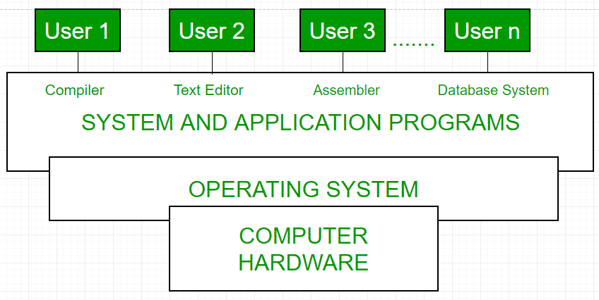
Reflect on the responses of post session activity
Recap
What is an Operating System?
Definition: An OS is system software that manages hardware and software resources.
Basic Functions:
Process Management
Memory Management
File Management
Security

Slide 3
Learning Outcomes
LO1: Critically analyze different types of operating systems and evaluate their suitability for various real-world applications.
LO2: Compare and contrast multiple operating system types based on efficiency, scalability, and user requirements.

Slide 4
Opening Question
"Computers, smartphones, and even embedded devices all uses operating systems, but not all OS are the same. Can you name different types of operating systems and their primary functions?"

Slide 5
Reflect on the responses of post session activity
Different types of Operating System?
Batch Operating System
Multitasking/Time-Sharing Operating System
Distributed Operating System
Real-Time Operating System (RTOS)
Network Operating System (NOS)
Multiprogramming Operating System
Multi-Processing Operating System
Multiuser Operating System

Slide 6
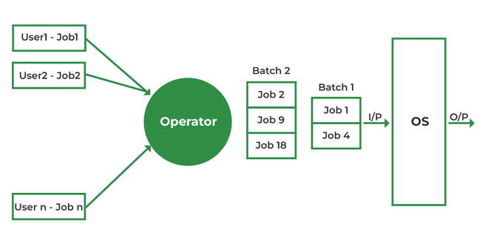
1) Batch Operating System
➤ Definition
A Batch OS executes a group of jobs (batch) without user interaction.
➤ Key Features
Jobs are collected and processed in sequence
No direct user interaction during execution
Suitable for large, repetitive tasks
➤ Real-Time Example
Payroll system in organizations
Imagine a teacher collecting all assignment copies and checking them after school in one go instead of checking one by one as students submit them.
*There is no direct interaction between the user and the computer while the job is running.
*Efficient for large data processing
Notes:
A Batch Operating System is an operating system that collects similar jobs into a batch and processes them one after another without user interaction during execution.
Users submit their jobs, and the system executes them automatically in sequence.
Users submit jobs (program + data).
Jobs are grouped based on similar requirements.
The system places them in a job queue.
CPU executes jobs one by one.
Output is generated after processing is complete.

Slide 7
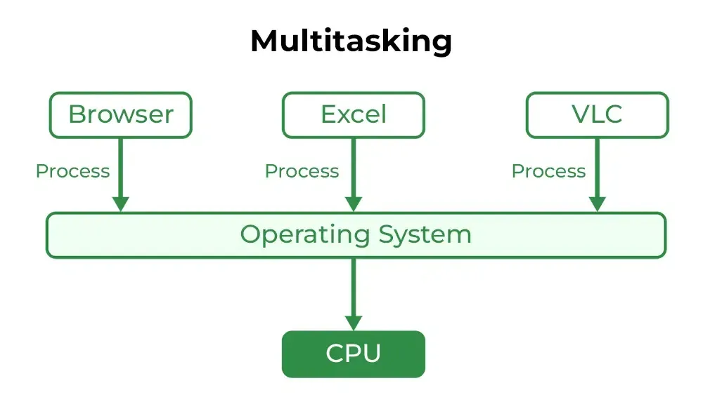
2) Time-Sharing Operating System
➤ Definition
Allows multiple users to share system resources simultaneously. Each user gets a small time slice of CPU.
➤ Key Features
Multi-user environment
Quick response time
CPU time divided into small slices
➤ Real-Time Example
University computer labs
Online servers
UNIX
*Imagine 5 students sharing one microphone in a debate. Each student gets 30 seconds, then the mic goes to the next student. Even though only one speaks at a time, everyone feels they are participating continuously.
Notes:
A Time-Sharing Operating System allows multiple users or multiple programs to share the CPU simultaneously.

Slide 8
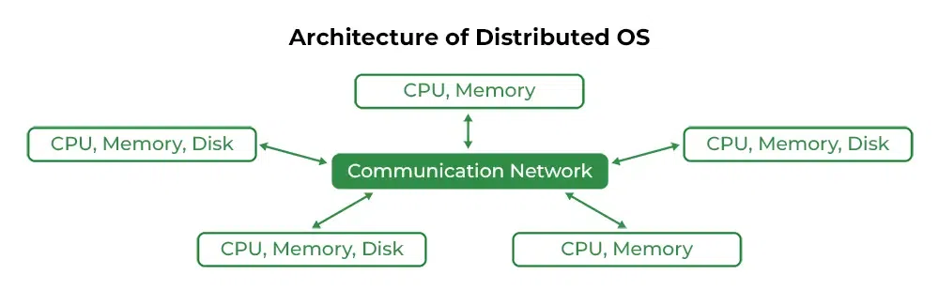
3) Distributed Operating System
➤ Definition
Manages multiple computers connected over a network and makes them appear as a single system.
➤ Key Features
Resource sharing
Fault tolerance
High performance
When a single system cannot handle
heavy workload, distributed systems are used.
➤ Real-Time Example
Cloud computing systems
Google data centers
Apache Hadoop
*Imagine 5 students solving one big assignment. Each student solves one part. Finally, all parts are combined into one complete answer.
Notes:
Multiple computers (nodes) are connected through a network and work together to share resources and complete tasks.

Slide 9
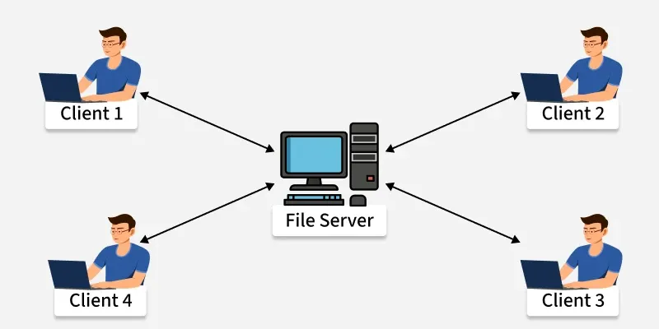
4) Network Operating System
➤ Definition
Provides services to computers connected in a network.
➤ Key Features
File sharing
Printer sharing
User management
➤ Real-Time Example
Office LAN
School computer lab server
Windows Server
30 students and Only 1 printer.
Printer is connected to the server. All students can print from their own system
👉 Printer sharing through a network is managed by a Network OS.
Notes:
A Network Operating System (NOS) is an operating system that manages and provides services to computers connected through a network.
It allows multiple computers (clients) to communicate and share resources such as files, printers, applications, and internet connections.

Slide 10
5) Real-Time Operating System (RTOS)
➤ Definition
Processes data and responds within a fixed time limit.
➤ Types
Hard Real-Time OS – Missing deadline is critical = System Failure
Soft Real-Time OS – Missing deadline reduces performance, but system continues
➤ Real-Time Example
Air traffic control systems
Medical monitoring systems
Pacemaker Devices
Traffic Signal System
When timer reaches zero → light must change immediately.
Delay may cause accident.
👉 System must respond at exact time → Real-Time OS.
Notes:
A Real-Time Operating System (RTOS) is an operating system that processes data and provides a response within a fixed and guaranteed time limit (called a deadline).
In RTOS, correctness depends not only on logical result but also on time of response.

Slide 11
6) Multiprocessing Operating System
➤ Definition
Uses two or more CPUs for execution.
➤ Key Features
Increased speed
Parallel processing
Better reliability
➤ Real-Time Example
Modern desktops
Systems running Windows 11
Systems running Linux
🔎 Classroom Example
👩‍🏫 Example 1: Checking Exam Papers
1 teacher checking 100 papers → Takes long time.
4 teachers checking 25 papers each → Work completes faster.
👉 Multiple teachers = Multiple CPUs 👉 Faster correction = Multiprocessing
Notes:
A Multiprocessing Operating System is an OS that uses two or more CPUs (processors) within a single computer system to execute multiple processes simultaneously.
All processors share main memory, I/O devices, and system resources.

Slide 12
Summary Table
Type | Main Feature | Example
Batch OS | No interaction | Payroll processing
Time-Sharing OS | Multi-user | UNIX
Distributed OS | Multiple systems as one | Hadoop
Network OS | Network resource sharing | Windows Server
RTOS | Time-bound response | Air traffic control
Multiprocessing OS | Multiple CPUs | Windows 11

Slide 13
Learning Activity 1: OS Classification Challenge (Group Activity)
Instructions:
Divide students into small groups.
Provide each group with a set of OS descriptions
Each group must match the descriptions with the correct OS type
Groups will explain their choices.
Expected Outcome: Helps students categorize OS types correctly and understand their features.

Slide 14
Learning Activity 1: OS Classification Challenge (Group Activity)
Description 1:
“Executes jobs in groups without user interaction and Used in early mainframes where tasks were processed sequentially. Example: Payroll processing in banks.”
Notes:
Answer: Batch Operating System Example: Early IBM mainframes, Payroll processing in banks.

Slide 15
Learning Activity 1: OS Classification Challenge (Group Activity)
Description 2:
“Allows multiple applications or tasks to run at the same time on a single CPU. Users can switch between applications without closing them. Commonly found in personal computers and mobile devices.".
Notes:
Answer: Time-Sharing Operating System Example: UNIX

Slide 16
Learning Activity 1: OS Classification Challenge (Group Activity)
Description 3:
“Controls a network of computers and makes them work as a single system. Users experience it as a unified computing resource, even though multiple computers are working together in the background.”
Notes:
Answer: Real-Time Operating System (RTOS) Example: Medical monitoring systems, aircraft control systems.

Slide 17
Learning Activity 1: OS Classification Challenge (Group Activity)
Description 4:
“Designed for critical applications where responses must occur within a strict time frame. Used in environments where delays could lead to failures or risks”
Notes:
Answer: Distributed Operating System Example: Google’s cloud infrastructure, Hadoop.

Slide 18
Learning Activity 1: OS Classification Challenge (Group Activity)
Description 5:
“Manages network resources and allows multiple computers to communicate over a shared network. Typically used in enterprise settings where centralized administration is required.”
Notes:
Answer: Multitasking Operating System Example: Windows, macOS.

Slide 19
Learning Activity 1: OS Classification Challenge (Group Activity)
Description 6:
“Allows multiple programs to be loaded into memory and executed simultaneously, improving CPU utilization by reducing idle time.”
Notes:
Answer: Multiuser Operating System Example: Linux servers handling multiple remote logins.

Slide 20
Learning Activity 1: OS Classification Challenge (Group Activity)
Description 7:
“Supports two or more CPUs working together to execute multiple processes simultaneously, improving performance and reliability.”
Notes:
Answer: Network Operating System (NOS) Example: Windows Server

Slide 21
Learning Activity 1: OS Classification Challenge (Group Activity)
Description 8:
“Allows multiple users to access the same system resources at the same time, ensuring efficient sharing of processing power and memory.”
Notes:
Answer: Network Operating System (NOS) Example: Windows Server

Slide 22
Learning Activity 2: Real-World OS Scenarios (Discussion + Brainstorming)
Objective: Apply knowledge of OS types to real-world scenarios.
Instructions:
Present real-world scenarios
Students to discuss which OS type is most suitable and why.
Encourage them to justify their answers with examples.
Expected Outcome: Enhances critical thinking by linking OS concepts to real-world applications.

Slide 23
Learning Activity 2: Real-World OS Scenarios (Discussion + Brainstorming)
Scenarios 1:
“A hospital uses a system that continuously monitors patients’ vital signs and triggers alarms if abnormal values are detected. The system must respond instantly without delay.”
Question: Which OS is best suited for this? Why?
Notes:
Answer: Real-Time Operating System (RTOS) – Ensures minimal latency and quick response for critical medical alerts.

Slide 24
Learning Activity 2: Real-World OS Scenarios (Discussion + Brainstorming)
Scenarios 2:
“A company uses a system where multiple users can store and access files from different locations. The data is stored across multiple servers worldwide to ensure fast access and fault tolerance.”
Question: Which OS is best suited for this? Why?
Notes:
Answer: Distributed Operating System – Ensures high availability and resource sharing across multiple machines.

Slide 25
Learning Activity 2: Real-World OS Scenarios (Discussion + Brainstorming)
Scenarios 3:
“A global airline allows thousands of customers to book tickets online at the same time. The system must handle multiple requests efficiently without delays.”
Question: Which OS is best suited for this? Why?
Notes:
Answer: Time-Sharing Operating System – Manages multiple user interactions simultaneously using CPU time slices.

Slide 26
Learning Activity 2: Real-World OS Scenarios (Discussion + Brainstorming)
Scenarios 4:
“A bank processes thousands of transactions per minute, including ATM withdrawals, online banking, and credit card payments. The system needs to handle multiple users and ensure security.”
Question: Which OS is best suited for this? Why?
Notes:
Answer: Multiuser Operating System – Supports multiple users accessing banking services securely and simultaneously.

Slide 27

QUIZ
Go to wooclap.com
Enter the event code in the top banner
Event code:
XRBDIG

Slide 28
Conclusion & Closure
To wrap up today’s session, we have explored various types of operating systems, their functionalities, and real-world applications. Through interactive activities, we classified different OS types and applied our knowledge to real-world scenarios. Understanding these concepts is fundamental to grasping how modern computing systems function efficiently.
Next Class:
In the next class, we will delve deeper into Operating System Architecture and Components, where we will explore:
Memory management techniques.
Hands-on discussion on how modern OS like Linux and Windows handle resource allocation.
Be ready for more interactive discussions and problem-solving exercises!

Slide 29
Feedback

